Slide 1

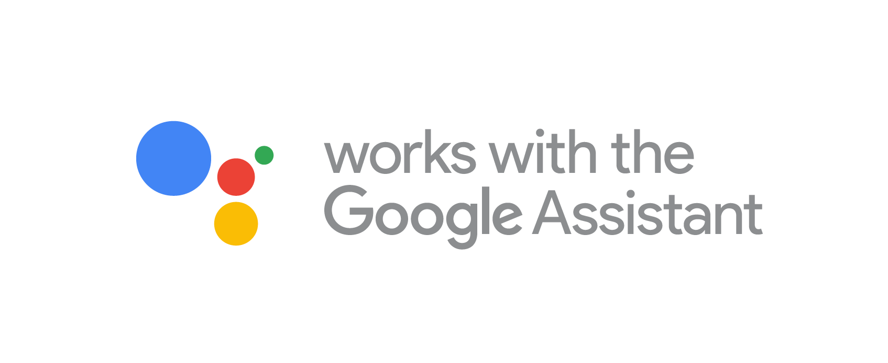
Actions on Google
Dialogflow & Actions on Google
Zubin Pratap | Manindra Arora
@ZubinPratap
Melbourne, 15 May 2019

Slide 2
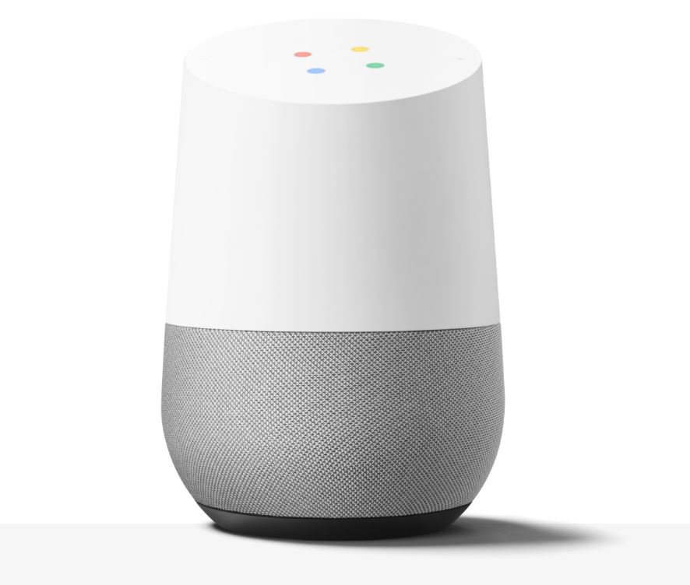
Conversational Interface for the Google Assistant
Google Assistant: AI- powered Virtual Personal Assistant
> 1 Billion devices (speakers, phones, cars, speakers, headphones, TVs…)
Conversational UI and Visual U/I
“Actions on Google” : Actions that you create extend Google Assistant’s functionality

Slide 3
3 Part Workshop
Part 1: Codelabs 1 - Terminology, Tools, Basic Concepts, simple app
Part 2: Codelabs 2 - API concepts
Part 3: Intermediate API Concepts

Slide 4
Key Concepts for Voice Apps
Term | Meaning
Actions | “An Action is an entry point into an interaction that you build for the Assistant. Users can request your Action by typing or speaking to the Assistant.” A collection of Actions makes up your voice app and is equivalent to an Alexa “skill” Actions are broadly in 3 categories : conversational, smarthome/IoT and content distribution
Invocation | The “trigger” phrase that starts the voice app interaction. Equivalent to the “wake word” in Alexa
Utterance | Whatever a user says that the Action is designed to handle/respond to.
Entities (slots) | A category of thing that the NLU model is trained to identify members of (eg colours, weights, fruit) - two types : user created and “system” (platform provided) entities
Intent | NLP term to describe the purpose of a given utterance. What is the intent (purpose) behind the user’s utterance? What do they want to achieve?
Fulfillment | Every Intent needs to be “fulfilled”. Responded to. That is typically done either using DialogFlow and/ or a fulfillment webservice accessed via a HTTP endpoint.

Slide 5
Two types of Conversation Projects
Dialogflow | Actions SDK
NLU Engine | BYO NLU Engine
Dialogflow is a conversational platform that lets you design and build Actions by wrapping the functionality of the Actions SDK and providing additional features such as an easy-to-use IDE, natural language understanding (NLU), machine learning, and more. | Actions on Google lets you extend the functionality of the Google Assistant with Actions. It integrates your Dialogflow conversational app with the Google Assistant, so you can invoke your application via the Google Assistant.
More commonly used, with lots of custom, built in, out-of-the-box functionality, IDE, ML etc. Very useful functionality includes built in intents (eg: Welcome Intent, fallback intent, exit intent) etc. | Provides the key interfaces and APIs that extend the Google Assistant.
Reference::https://developers.google.com/actions/extending-the-assistant

Slide 6
Today: Workshop 1
=> set up invocation of a google action
=> parse spoken user input for a specific parameter (a colour)
=> based on the colour, return a “lucky number”
=> if no colour is provided (or some utterance is not relevant), prompt the user
=> users can explicitly exit the conversation
Actions | Google Actions Console | DialogFlow Agent | NLU Training Phrases
Console Actions Simulator | “slot filling” and “entities” | Actions on Google Client SDK | Dialogflow editor

Slide 7
Let’s get setup and code!
QUESTIONS?

Slide 8
Let’s get setup and code!
Codelabs: https://codelabs.developers.google.com/codelabs/actions-1/#2
( Or just google “google codelabs + actions”)
Console:
https://console.actions.google.com/

Slide 9
Internal Only: copy for comms to community
Hack Night Meetup + Slack:
GDG is running introductory sessions for those who want to learn to write apps for the Google Assistant. Join us over 3 workshops as we take you through the fundamentals from terminology to writing your own Dialogflow and Actions on Google with custom fulfillment using Firebase Functions.
This is for all those of you who have wanted to build your own Google Assistant App, and can’t be bothered diving into all the NLP stuff.

Slide 10
Twitter:
Join us over 3 workshops as we take you through the fundamentals of writing your own Dialogflow and Google Assistant voice apps with custom fulfillment using Firebase Functions.
We will make it easy for you to get your first intermediate level Assistant app up and running!

